Slide 1
Local Board of Health Training
Meagan K. Gillespie, BS
(406-444-5563; Meagan.gillespie@mt.gov)
Todd S. Harwell, MPH
(406-475-5907; tharwell@mt.gov)

Slide 2
Topics
Introduction to public health
Montana statutes and administrative rules
Overview of Department of Public Health and Human Services and Public Health and Safety Division
Health improvement planning

Slide 3
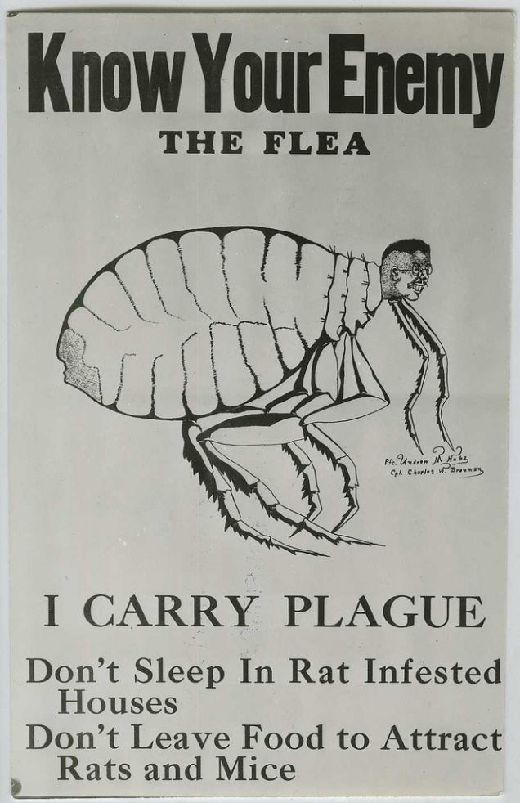
What is Public Health?
“The activities that ensure conditions in which people can be healthy. These activities include community wide efforts to identify, prevent, and combat threats to the health of the public.” —
Institute of Medicine

Slide 4
What does Public Health do?
Prevents epidemics and the spread of disease
Protects against environmental hazards
Prevents injuries
Promotes and supports healthy behaviors
Preparing for, responding to, and recovering from public health emergencies
Assures the quality and accessibility of health services

Slide 5
Primary Care versus Public Health
Public Health
Population
Prevention & Control of Disease
Primary Care
Patient
Treatment of Disease
What does medicine do?
Saves lives one at a time
What does public health do?
Saves lives millions at a time

Slide 6
Improved Life Expectancy

Slide 7
Improved Life Expectancy

Slide 8

Improved Life Expectancy
Public health advances were responsible for 25 of the 30 years of life gained in the 20th century

Slide 9

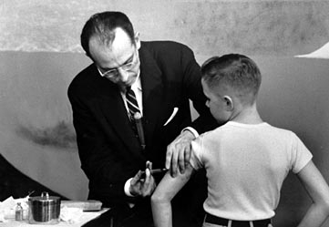

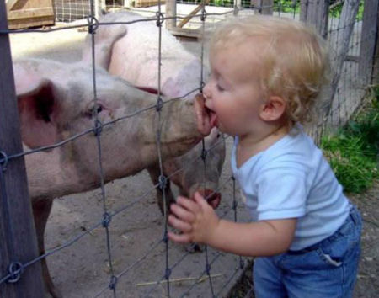
Public Health: Past, Present and Future
Achievements of 20th Century
Emerging threats of 21st Century
Vaccinations
Improved sanitation
Fewer deaths from heart disease and stroke
Healthier mothers and babies
Reduction in tobacco use
Chronic diseases
Obesity
Influenza like H1N1
New and re-emerging infectious diseases like Covid, Syphilis, and Ebola
Natural disasters

Slide 10
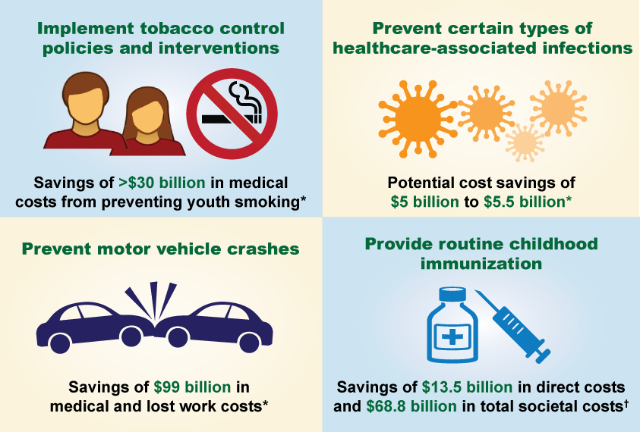
What is the value of public health?

Slide 11
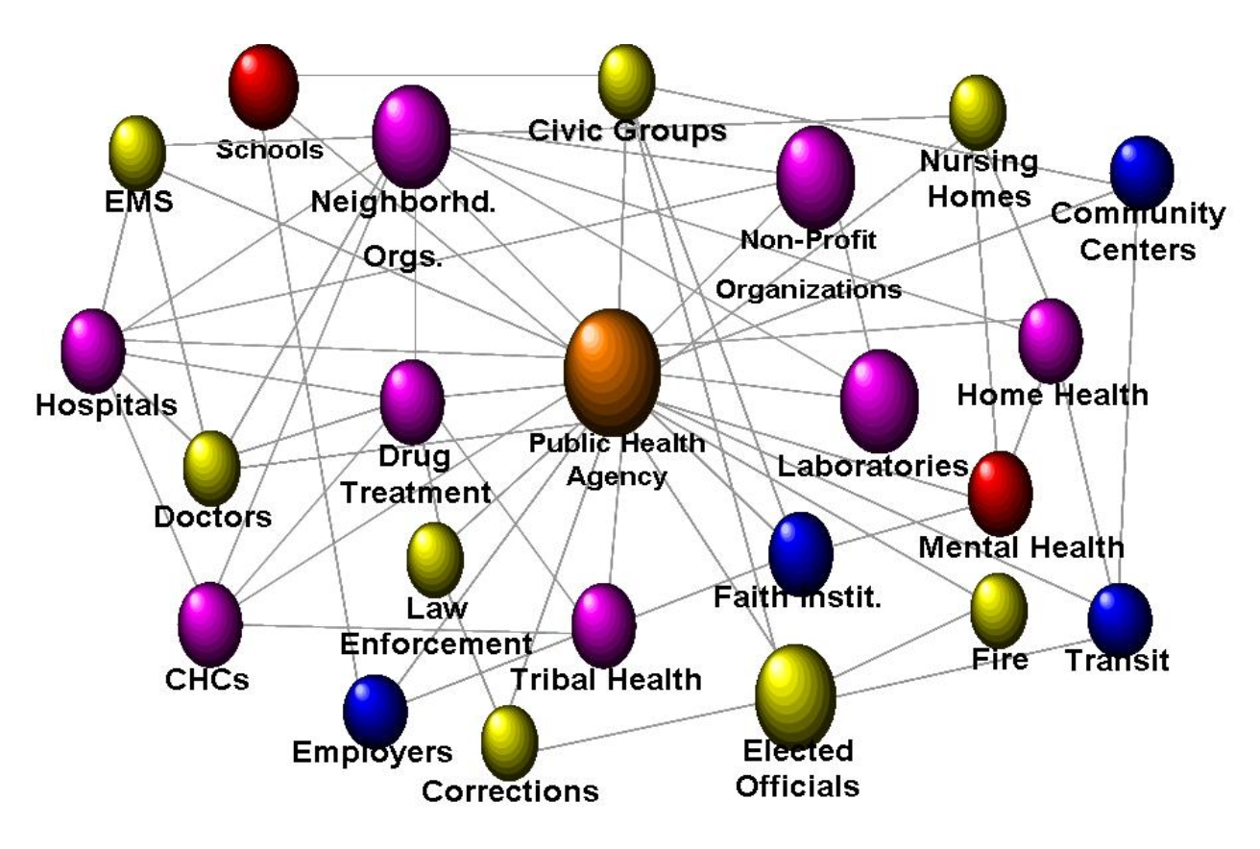
Public Health System

Slide 12
Core Functions and 10 Essential Public Health Services
Provide a framework for public health services and responsibilities that should be undertaken in all communities
Incorporated in Montana Statutes

Slide 13
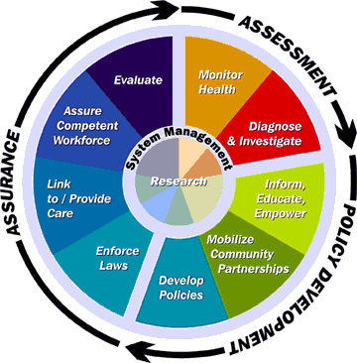
Core Functions of Public Health
Assessment
Policy Development
Assurance
Notes:
Reminder! Come back at the end to discuss where this HD is in regard to the FPHS

Slide 14
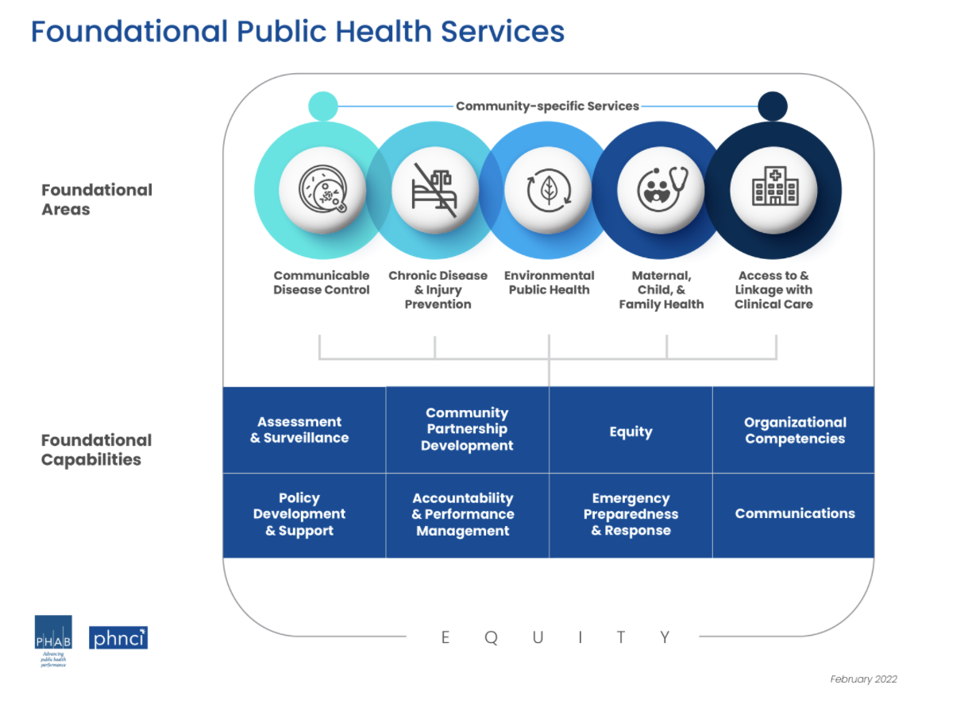

Slide 15
Montana Statutes
Why we do what we do

Slide 16
Sources of Legal Authorities for Public Health
Montana Code Annotated
  Title 50, Health and Safety; Chapter 1: Administration of Public Health Laws
  Scattered throughout statutes
Administrative Rules of Montana (ARMS)
Montana Courts
Attorney General opinions
Local governing bodies
Municipal codes

Slide 17
Differences Between Statutes and Rules
Statute
  Written law passed by legislature
  Usually broad and general
  Requires legislative process to change, amend, or repeal
  Or court can strike down or issue an injunction
  Number separated by dashes
  Example: 50-2-116, Powers and duties of local boards of health
Rule
  Agency regulations promulgated upon grant of rule making authority from legislation
  Usually elaborate requirements of statute or policy
  Force and effect of law
  Agency can change, adopt, remove, but requires public notice and participation
  Number separated by dots
  Example: 37.114.203, Reportable diseases and conditions

Slide 18
Purpose of Public Health System in Montana per Statutes
Promote conditions in which people can be healthy
Provide or promote the provision of public health services and functions including the 10 Essential Public Health Services
Seek adequate funding for services
Collaborate with private and public partners

Slide 19
Purpose of Public Health System in Montana per Statutes
Use the best science available
Strive to ensure public health services and functions are provided
Implement public health services and functions, health promotion, and preventive health services within the state health care system

Slide 20
Collaboration and Relationships within Public Health System
Variety of agreements may be formed among federal, state, local, and Tribal agencies to coordinate provision of public heath services
Agreements do not have to be with contiguous jurisdictions
Jurisdictions on state border may form agreements with an adjoining state
Local agencies may form agreements with Tribal governments

Slide 21
Types of Local Boards of Health
County Boards of Health
City Boards of Health
City-County Boards of Health
District Boards of Health
Notes:
Todd to give some history on BOH

Slide 22
County and City Local Board of Health Membership
Minimum of 5 members
Appointed by city or county commissioners
3-year staggered terms
Often board is county commission plus two additional appointments
Membership for city-county board of health can be determined locally or by agreement

Slide 23
Funding Sources for Local Health Departments
General fund appropriations
Special levy fund appropriations
State and federal funds available
Contributions from school boards
Other official and nonofficial sources

Slide 24
Legal Counsel
County attorney serves as legal advisor

Slide 25
Local Board of Health Shall….
Recommend to local governing body appointment of a health officer
Health officer must be a physician or a person with a master’s degree in public health, or a person with equivalent education and experience, as determined by DPHHS
State health department may appoint a local health officer if the local governing body does not

Slide 26
Local Boards of Health Shall….
Elect a presiding officer and other necessary officers
Identify to DPHHS an administrative liaison for public health
Adopt bylaws to govern meetings
Hold regular meetings at least quarterly and special meetings as necessary

Slide 27
Local Boards of Health Shall…
Identify, assess, prevent, and ameliorate conditions of public health importance using current public health practices such as:
  Epidemiological tracking and investigation
  Screening and testing
  Isolation and quarantine
  Diagnosis, treatment, and case management
  Abatement of public health nuisances
  Inspections
  Collecting and maintaining health information
  Education and training of health professionals; or
  Other public health measures as allowed by law

Slide 28
Local Boards of Health Shall…
Protect against the introduction and spread of communicable disease
Supervise inspections of public establishments for sanitary conditions
Pursue legal actions for violations of public health laws, rules, or local regulations
Propose for adoption by the local governing body sewage control regulations for buildings not subject to state review

Slide 29
Local Boards of Health May…
Accept and spend funds from federal or state agencies, school districts, or other persons
Propose for adoption by the local governing body necessary fees to administer sewage control requirements

Slide 30
Local Boards of Health May…
Propose for adoption by the local governing body rules that do not conflict with state rules:
  To implement public health laws
  For communicable disease control
  For certain sanitation and sewage treatment issues
  For tattooing and body piercing establishments
  For certain institutional controls
Provide other services and functions as necessary

Slide 31
Does “may” mean these authorities are optional?
Powers and authorities enable a local board to meet public health obligations in its jurisdiction
Montana case law: “may” becomes imperative when rights of the public are involved (public protection or safety require action to be taken)

Slide 32
Quasi-Judicial Authorities of Local Boards of Health
Act as an appeal board when a decision of a health officer is challenged
Hear and act on matters pertaining to requests for exemptions (variances) from state or local rules

Slide 33
Local Health Officers Shall…
Make inspections for conditions of public health importance and issue written orders for correction, destruction, removal of the condition
Limit contact between people in order to control disease, including ordering closure of buildings, canceling events
Report communicable diseases to DPHHS as required by rule
Pursue legal action for violations of public health laws

Slide 34
Other Important Legal Considerations for Local Health Officers (and their designees)
May request assistance from law enforcement
Can issue orders to compel compliance with laws/rules
Can order removal of prisoners from jail if dangerous to health of others
Must maintain confidentiality of health care information

Slide 35
Limitations/Restrictions
Montana’s open meeting and public participation laws
  Meetings must be open to the public
  Advance notice of the matter the board will hear or act upon
  Procedures to allow the public a reasonable opportunity to participate prior to making decision of “significant interest to the public”
  Minutes kept and made available for review

Slide 36
Limitations/Restrictions
Open meeting requirements may conflict and may have to give way to:
  Individual’s privacy rights
  Confidentiality requirements
  Montana’s Health Care Information Act
  HIPAA privacy rules
  *A good idea to seek legal counsel if a board is discussing or acting on information that could be considered confidential

Slide 37
What does this mean for your board of health?
Power is with local governance for public health
Work with county attorney if have questions
Technical assistance at PHSD
Contact other local public health jurisdictions

Slide 38
Administrative Rules of Montana
Agency regulations that have the force and effect of law
Generally elaborate the requirements of a law or policy
Montana ARMS: http://mtrules.org/

Slide 39
Example of an ARM Applicable to a Local Health Department
37.114.203 REPORTABLE DISEASES AND CONDITIONS
(1) The following communicable diseases and conditions are reportable:
(a) AIDS, as defined by the Centers for Disease Control and Prevention, and HIV infection, as determined by a positive result from a test approved by the Federal Food and Drug Administration for the detection of HIV, including, but not limited to, antibody, antigen, and all HIV nucleic acid tests;
(b) Anaplasmosis;
(c) Anthrax;
(d) Arboviral Disease (California serogroup, Eastern equine encephalitis, Powassan, Saint Louis encephalitis, West Nile Virus, Western equine encephalitis);
(e) Babesiosis;
(f) Botulism (including infant botulism);
And many more!

Slide 40
As a Board of Health member what can you do to help public health in your jurisdiction?

Slide 41
Ensure board of health meetings occur at least quarterly
Work with your local public health department on important public health issues such as policy development and implementation of programs
Participate and be the champion for community health improvement and strategic planning
Support securing funding for your local health department
Review and be aware of the health status of your community
Support your health department in their process of becoming accredited or Pathways to Recognition

Slide 42
Public Health in Montana

Slide 43
How is Public Health Organized in Montana?
Decentralized system
Montana law requires that every county (or 1st or 2nd class city) shall have a board of health
Department of Public Health and Human Services (DPHHS) provides state coordination and support to the counties

Slide 44


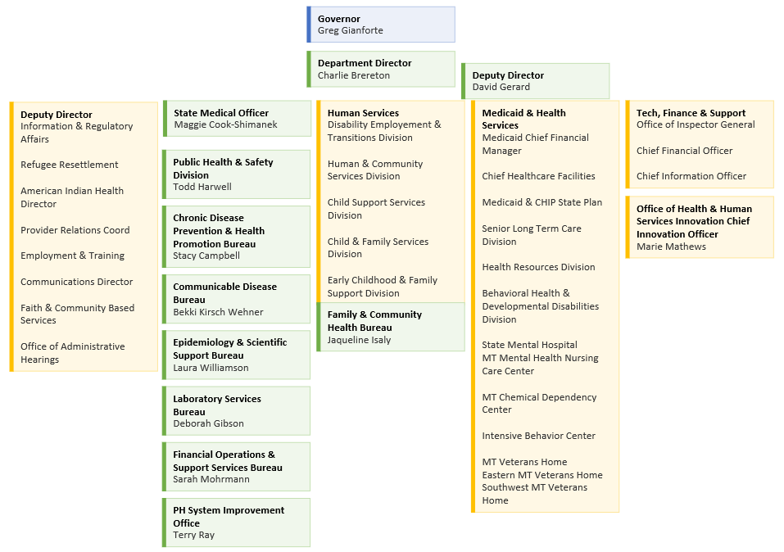




Slide 45
DPHHS Overview
Largest agency of state government
Biennial budget of ~$5 billion
3,000+ employees, 2,500 contracts, and 150 major programs
  In comparison to MT State Government with 11K staff
Director’s Office + Three branches
Eleven divisions

Slide 46
Public Health and Safety Division
Provide state-level coordination of key public health services to local and Tribal public health agencies
One Division + one Bureau
40 programs
220+ employees

Slide 47
PHSD Administrator & State Health Officer
Todd Harwell
State Medical Officer
Maggie Cook-Shimanek
Chronic Disease Prevention and Health Promotion Bureau
Stacy Campbell
Communicable Disease Control and Prevention Bureau
Bekki Kirsch-Wehner
Laboratory Services Bureau
Debbie Gibson
Epidemiology and Scientific Support
Laura Williamson
Public Health System Improvement Office
Terry Ray
Financial and Operations Bureau
Sarah Mohrmann
Arthritis, Asthma control, Cancer Control, Cardiovascular, CONNECT, Diabetes, Disability & Health, EMS & Trauma, Injury Prevention, Montana School Health, MT Tobacco Use Prevention, Nutrition & Physical Activity, Worksite Wellness
Food and Consumer Safety
Immunization
STD/HIV Prevention
Emergency Preparedness
Public health laboratory
Environmental laboratory
Laboratory system improvement
Financial Support
Environmental Health
Substance use disorder surveillance & evaluation
Communicable Disease Epidemiology
Surveillance & Informatics
Epidemiology, WFD & Planning
Local & Tribal Support
Strategic Planning
Performance Mgmt. &
Quality Improvement
Workforce Development
Financial Operations
Vital Records

Slide 48
PHSD’s Role
Provide state-level coordination of key public health services
Provide information, consultation, and support for local boards of health
Provide technical assistance for community health planning
Provide technical assistance as needed or requested by subject area

Slide 49
State Health Improvement Planning

Slide 50
State Health Assessment (SHA)
First SHA completed in 2012
Updated every 5 years
Details information on access to health care, causes of death, chronic diseases, communicable diseases, maternal and child health, unintentional injury, mental health substance abuse, environmental health, and social determinates of health
Identifies health priorities
Serves as basis for the State Health Improvement Plan

Slide 51
State Health Improvement Plan (SHIP)
    Developed by PHSD and stakeholders
      SHA/SHIP Coalition
    Gathered information from multiple presentations and meetings with diverse groups (e.g., MACO, Tribal Health leaders)
    Five priority focus areas for next five years
    Annual progress reports released every January
    To provide feedback go to:
    http://ahealthiermontana.mt.gov/shaship

Slide 52


Slide 53
Community Health Planning

Slide 54







Slide 55
Community Health Assessment (CHA)
A process that engages with community members and local public health system partners to systematically collect and analyze qualitative and quantitative health-related data from a variety of sources within a specific community
In other words, taking steps to understand the health status and health risk in a community using data from multiple sources

Slide 56
Public Health System

Slide 57
Community Health Improvement Plan (CHIP)
Action-oriented plan outlining priority community health issues (based on the CHA and stakeholder input) and how these issues will be addressed, including strategies and measures, to ultimately improve the health of the community
In other words, working together as a community to address a health issue or issues

Slide 58
Benefits of a CHIP
Community participation
Valuable information to direct health efforts
Used to for grant applications
Provides data for state-level health planning
Accreditation requirement

Slide 59
Forces at Work
Tax-exempt hospitals requirement for IRS
  Conduct a community health needs assessment and implementation strategy
  Involve community members and public health experts
  At least once every 3 years
Voluntary Public Health Accreditation Board
  Requires a community health assessment and community health improvement plan
Economic pressure
  Greater need to conserve resources, work together in collaborative ways
More national emphasis on prevention strategies

Slide 60
What is the value of partnering?
Share costs and resources
Maximize resources
Brings more credibility in the community
Brings more stakeholders to the table and more buy-in
Able to extend population/demographic reach

Slide 61
Strategic Planning
Roadmap for health department
Living document to update regularly
Defines and determines health department’s roles, priorities, and direction over three to five years
Answers the following:
  What does the department plan to achieve as an organization?
  How will you achieve it?
  How will you know when you have achieved it?
Strategic, not all encompassing

Slide 62
Benefits of a Strategic Plan
Anticipate problems
Become adaptable
Ensure effectiveness
Allocate resources to priority areas
Keep focused on the department’s purpose
Communicate with stakeholders about the department’s roadmap
Updated every 3-5 years, reviewed annually

Slide 64
Questions?

